Slide 1
Drifting games and online Learning
Yoav Freund
UCSD

Slide 2
Discrete online learning
Our goal is to predict a binary sequence:
0,0,1,0,1,?
We are given access to the predictions of N experts
expert 1: 0,0,0,0,1,1
expert 2: 0,1,0,0,0,0
…
We want to combine the predictions of the experts for bit t and come up with our prediction for bit t

Slide 3
The discrete online learning game
On iteration t:
Experts give their predictions
Learning algorithm chooses its prediction
Adversary chooses outcome
Algorithm and experts incur loss 0 (no-mistake) or 1 (mistake)
Goal: total number of mistakes made by algorithm not much larger than number of mistakes made by best expert (in hind-sight).

Slide 4
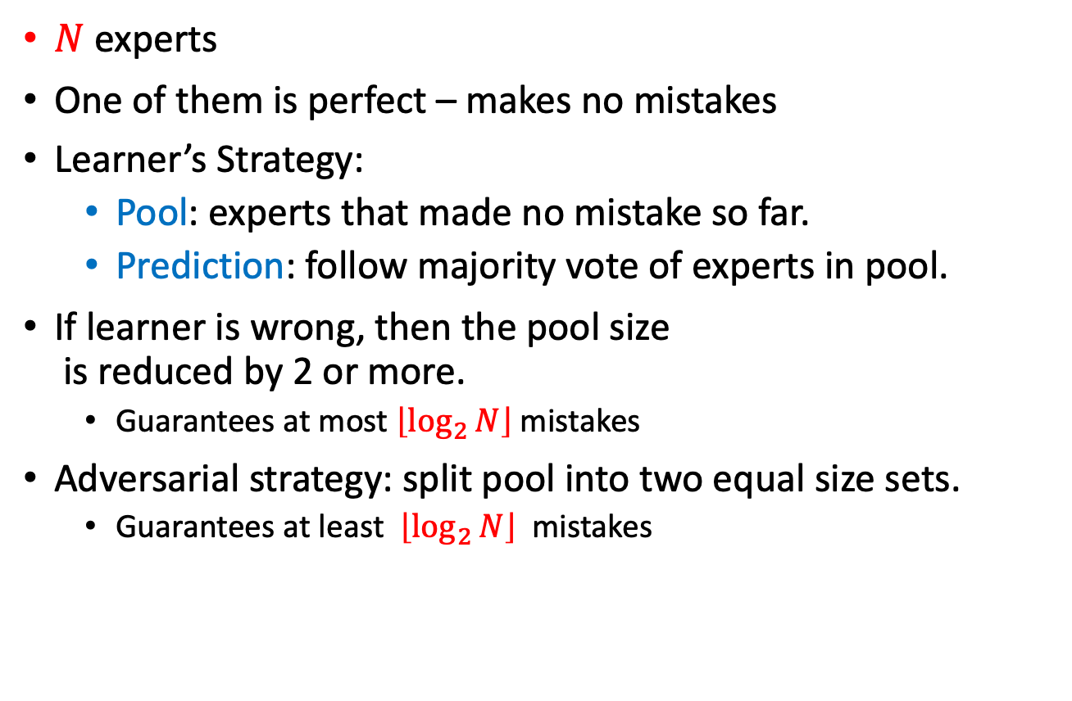

$$The halving game$$
$N$ experts
One of them is perfect – makes no mistakes
Learner’s Strategy:
Pool: experts that made no mistake so far.
Prediction: follow majority vote of experts in pool.
If learner is wrong, then the pool size is reduced by 2 or more.
Guarantees at most $\left\lfloor \log_{2}{N}\right\rfloor$mistakes
Adversarial strategy: split pool into two equal size sets.
Guarantees at least $\left\lfloor \log_{2}{N}\right\rfloor$ mistakes

Slide 5
Assume learner makes a mistake on this turn
Learner predicts 0
and makes a mistake
Pool
Not Pool
Pool
Not Pool
Learner predicts 1
and makes a mistake
Expert predicts 0
Pool
Expert predicts 1
Not Pool

Slide 6
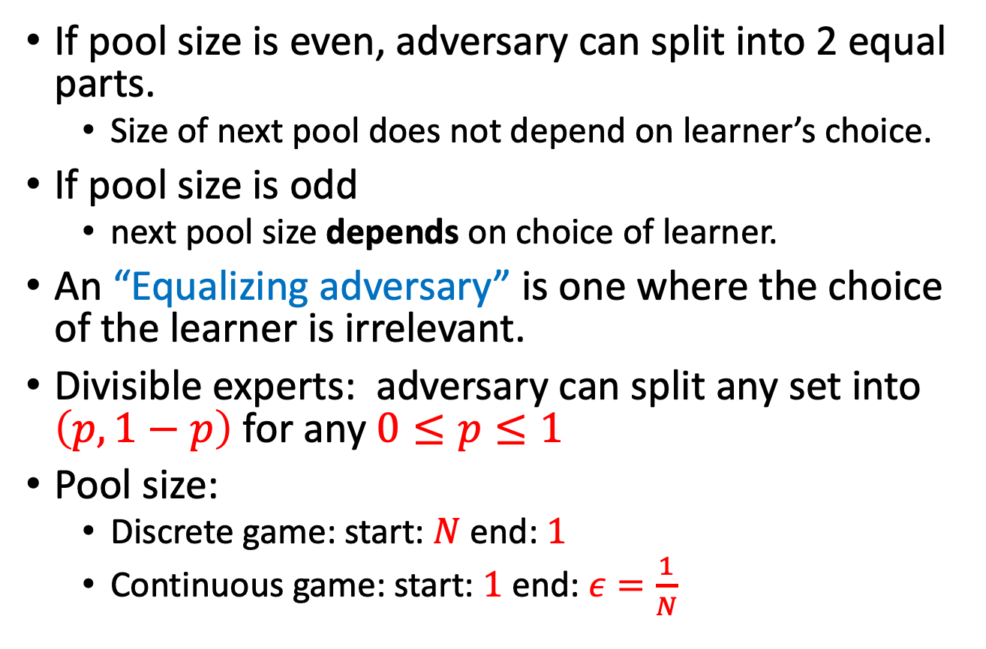
Equalizing adversary
If pool size is even, adversary can split into 2 equal parts.
Size of next pool does not depend on learner’s choice.
If pool size is odd
next pool size depends on choice of learner.
An “Equalizing adversary” is one where the choice of the learner is irrelevant.
Divisible experts: adversary can split any set into $\left(p,1−p\right)$ for any $0≤p≤1$
Pool size:
Discrete game: start: $N$ end: $1$
Continuous game: start: $1$ end: $ε=\frac{1}{N}$

Slide 7
Playing against the equalizing strategy
The equalizing strategy is optimal, the choice of the learner is irrelevant.
If the adversary plays suboptimally, the player should make the better choice under the assumption that from now on, the adversary will always play optimally.

Slide 8
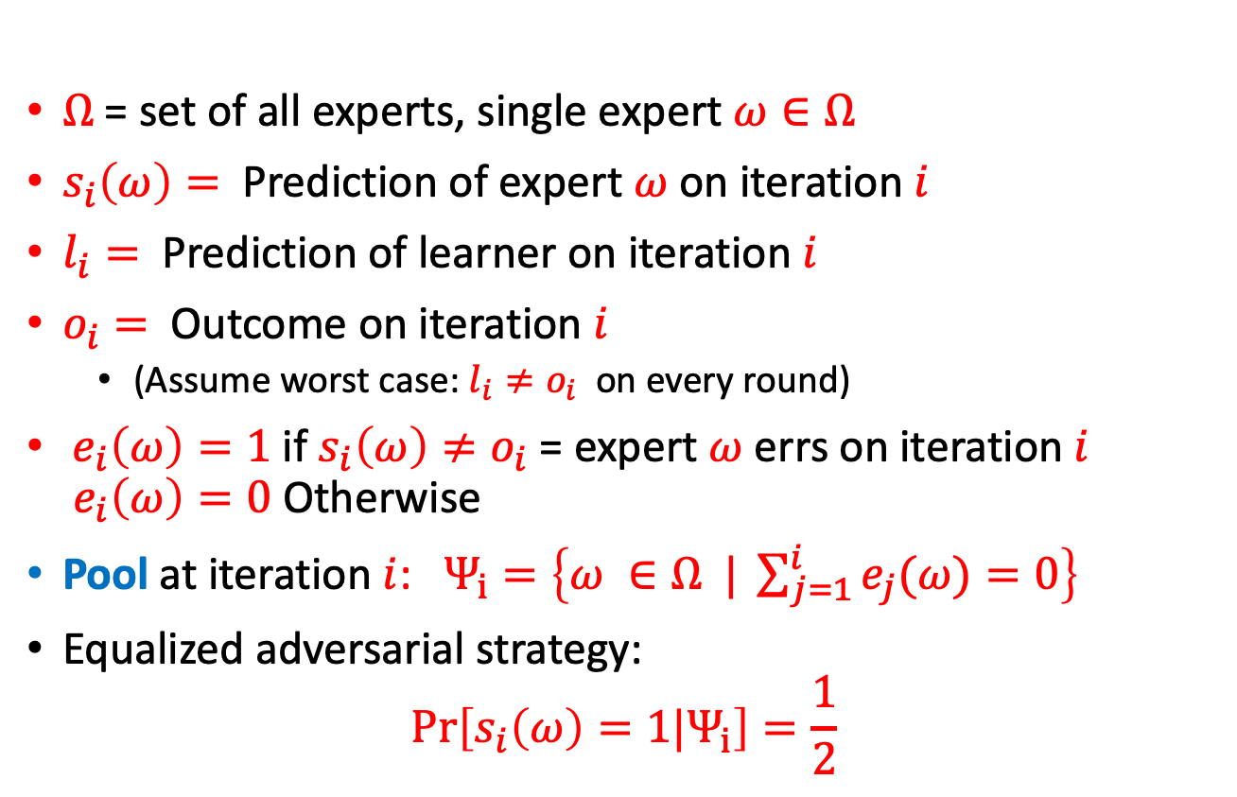
Probabilistic interpretation
$Ω$= set of all experts, single expert $ω∈Ω$
$s_{i}\left(ω\right)=$ Prediction of expert $ω$on iteration $i$
$l_{i}=$ Prediction of learner on iteration $i$
$o_{i}=$ Outcome on iteration $i$
(Assume worst case: $l_{i}≠o_{i}$ on every round)
$e_{i}\left(ω\right)=1$ if $s_{i}\left(ω\right)≠o_{i}$= expert $ω$ errs on iteration $i$ $e_{i}\left(ω\right)=0$ Otherwise
Pool at iteration $i$: $Ψ_{i}=\left\{ω ∈Ω | \sum_{j=1}^{i}{e_{j}(ω)}=0\right\}$
Equalized adversarial strategy: $\operatorname{Pr}\left[s_{i}\left(ω\right)=1|Ψ_{i}\right]=\frac{1}{2}$

Slide 9
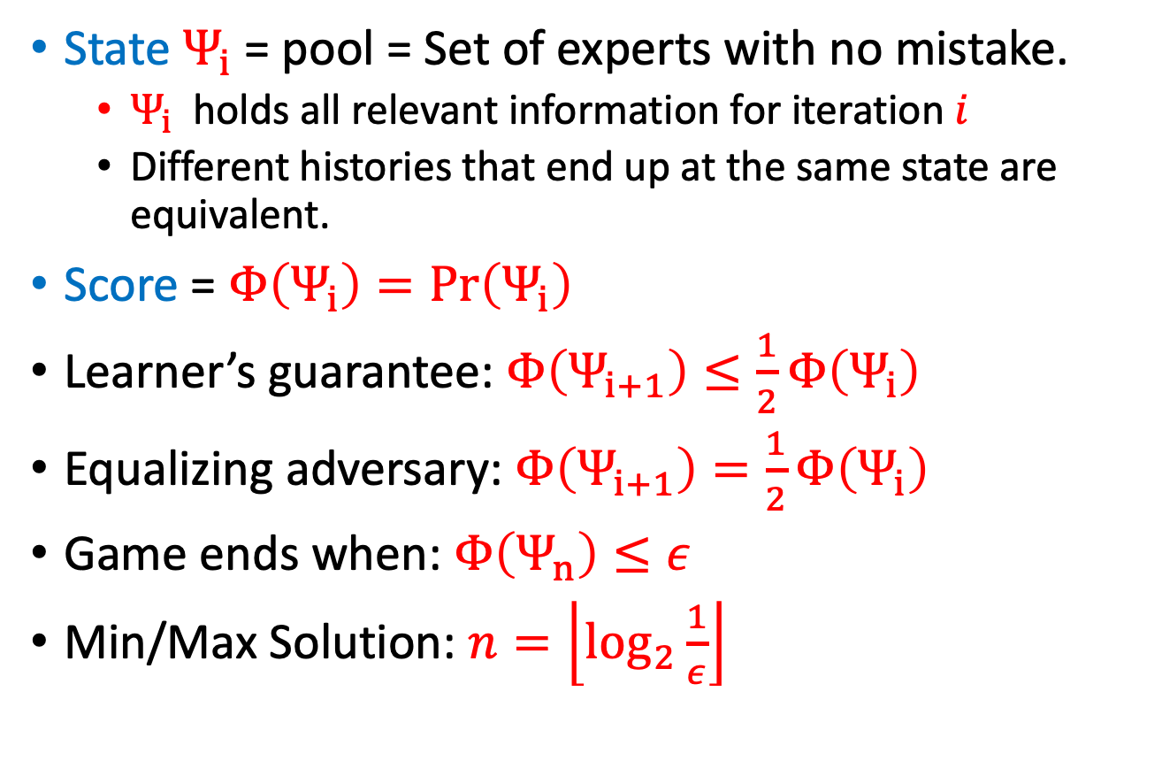
State, Potential and Equalization
State $Ψ_{i}$= pool = Set of experts with no mistake.
$Ψ_{i}$ holds all relevant information for iteration $i$
Different histories that end up at the same state are equivalent.
Score = $Φ\left(Ψ_{i}\right)=\operatorname{Pr}\left(Ψ_{i}\right)$
Learner’s guarantee: $Φ\left(Ψ_{i+1}\right)≤\frac{1}{2}Φ\left(Ψ_{i}\right)$
Equalizing adversary: $Φ\left(Ψ_{i+1}\right)=\frac{1}{2}Φ\left(Ψ_{i}\right)$
Game ends when: $Φ\left(Ψ_{n}\right)≤ε$
Min/Max Solution: $n=\left\lfloor \log_{2}{\frac{1}{ε}}\right\rfloor$

Slide 10
Plan Of Talk
Online learning games
The Halving Game
The Binomial Game
Decision Theoretic Online Learning (DTOL)
Hedge
The continuous time limit and the heat equation.
NormalHedge
SDEs
Open Problems

Slide 11
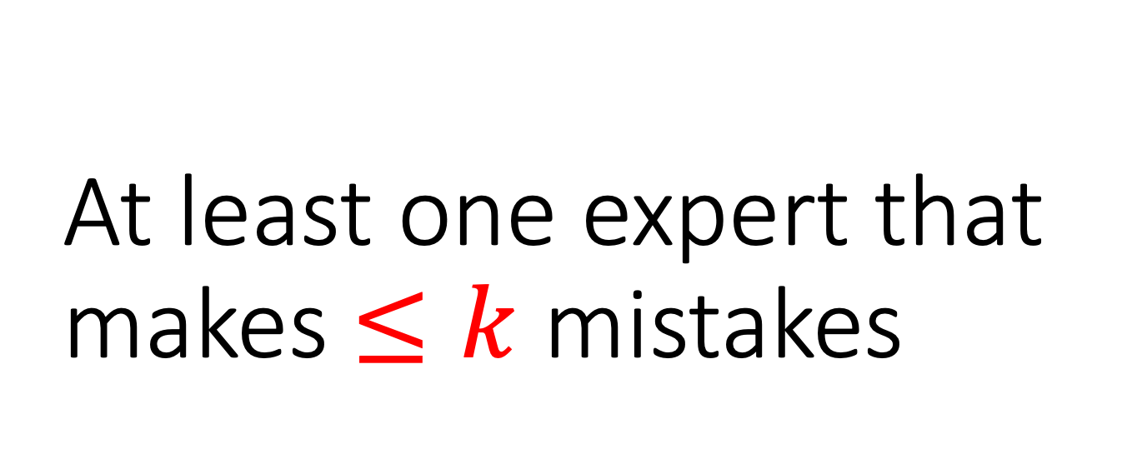
At least one expert that makes $≤k$ mistakes
Cesa-Bianchi, F, Helmbold, Warmuth, 1996, On-line prediction and conversion strategies

Slide 12
There exists an expert that makes no more than K mistakes.
Start
End
By following this expert the learner will not
make any more errors
0
1
K
Not in pool
0
1
K
Not in pool
No of mistakes made by expert
No of mistakes made by expert

Slide 13
Experts predicting 0
Experts predicting 1
Outcome=1
Outcome=0

Slide 14
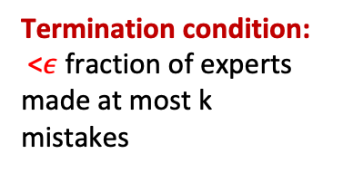
Optimal Adversary for K mistakes game
Equalizing strategy:
Split each bin into 2 equal parts
Assumes divisibility
Termination condition:
<$ε$ fraction of experts made at most k mistakes
Experts predicting 0
Experts predicting 1
learner=0, outcome=1
learner=1, outcome=0

Slide 15
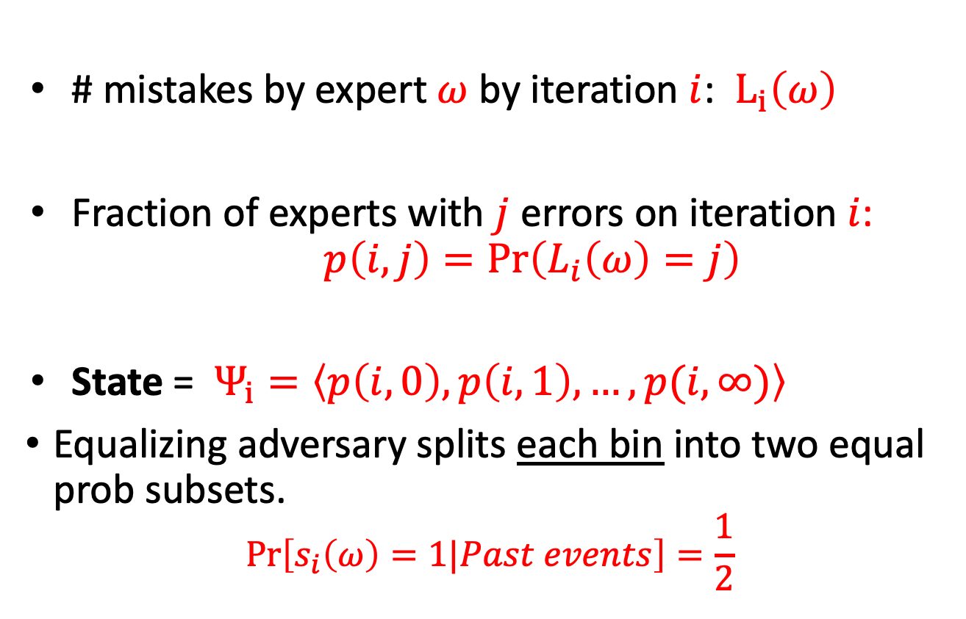
Interpretation as a random process
# mistakes by expert $ω$ by iteration $i$: $L_{i}\left(ω\right)$
Fraction of experts with $j$ errors on iteration$i$: $p\left(i,j\right)=\operatorname{Pr}\left(L_{i}\left(ω\right)=j\right)$
State = $Ψ_{i}=\left\langle p\left(i,0\right),p\left(i,1\right),…,p(i,∞)\right\rangle$
Equalizing adversary splits each bin into two equal prob subsets.
$$\operatorname{Pr}\left[s_{i}\left(ω\right)=1|Past events\right]=\frac{1}{2}$$

Slide 16
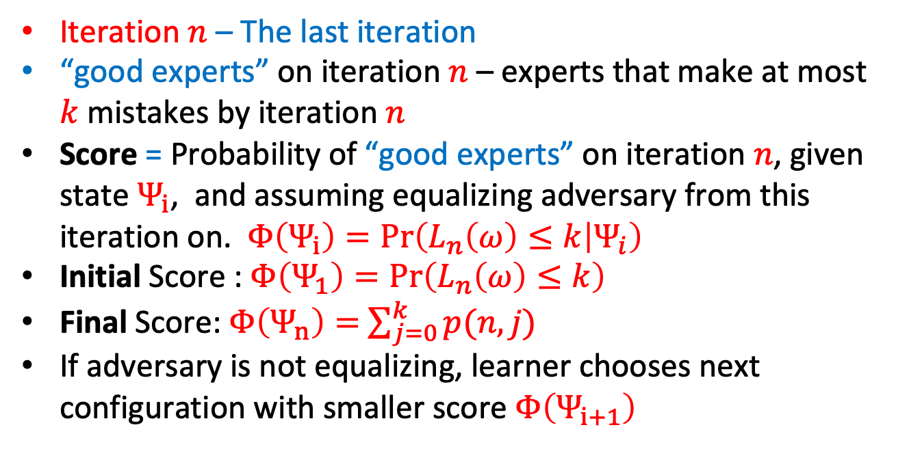
Interpretation as a random process
Iteration $n$ – The last iteration
“good experts” on iteration $n$ – experts that make at most $k$mistakes by iteration $n$
Score = Probability of “good experts” on iteration $n$, given state $Ψ_{i}$, and assuming equalizing adversary from this iteration on. $Φ\left(Ψ_{i}\right)=\operatorname{Pr}\left(L_{n}\left(ω\right)≤k | Ψ_{i}\right)$
Initial Score : $Φ\left(Ψ_{1}\right)=\operatorname{Pr}\left(L_{n}\left(ω\right)≤k\right)$
Final Score: $Φ\left(Ψ_{n}\right)=$ $\sum_{j=0}^{k}{p(n,j)}$
If adversary is not equalizing, learner chooses next configuration with smaller score $Φ\left(Ψ_{i+1}\right)$

Slide 17
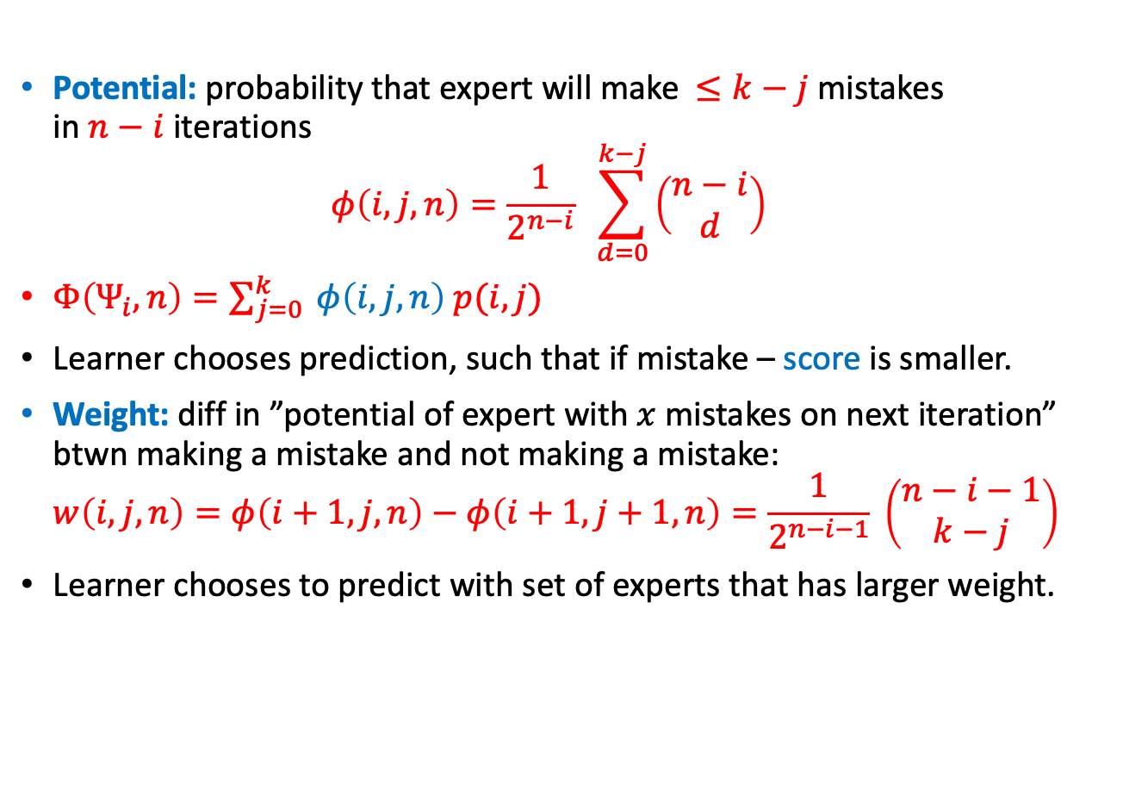
Solution: Binomial weights
Potential: probability that expert will make $≤k−j$mistakes in $n−i$ iterations $φ\left(i,j,n\right)=\frac{1}{2^{n−i}} \sum_{d=0}^{k−j}{\left(\begin{matrix}n−i \\ d\end{matrix}\right)}$
$Φ\left(Ψ_{i},n\right)=\sum_{j=0}^{k}{ φ\left(i,j,n\right) p(i,j)}$
Learner chooses prediction, such that if mistake – score is smaller.
Weight: diff in ”potential of expert with $x$ mistakes on next iteration” btwn making a mistake and not making a mistake: $w\left(i,j,n\right)=φ\left(i+1,j,n\right)−φ\left(i+1,j+1,n\right)=\frac{1}{2^{n−i−1}} \left(\begin{matrix}n−i−1 \\ k−j\end{matrix}\right)$
Learner chooses to predict with set of experts that has larger weight.

Slide 18
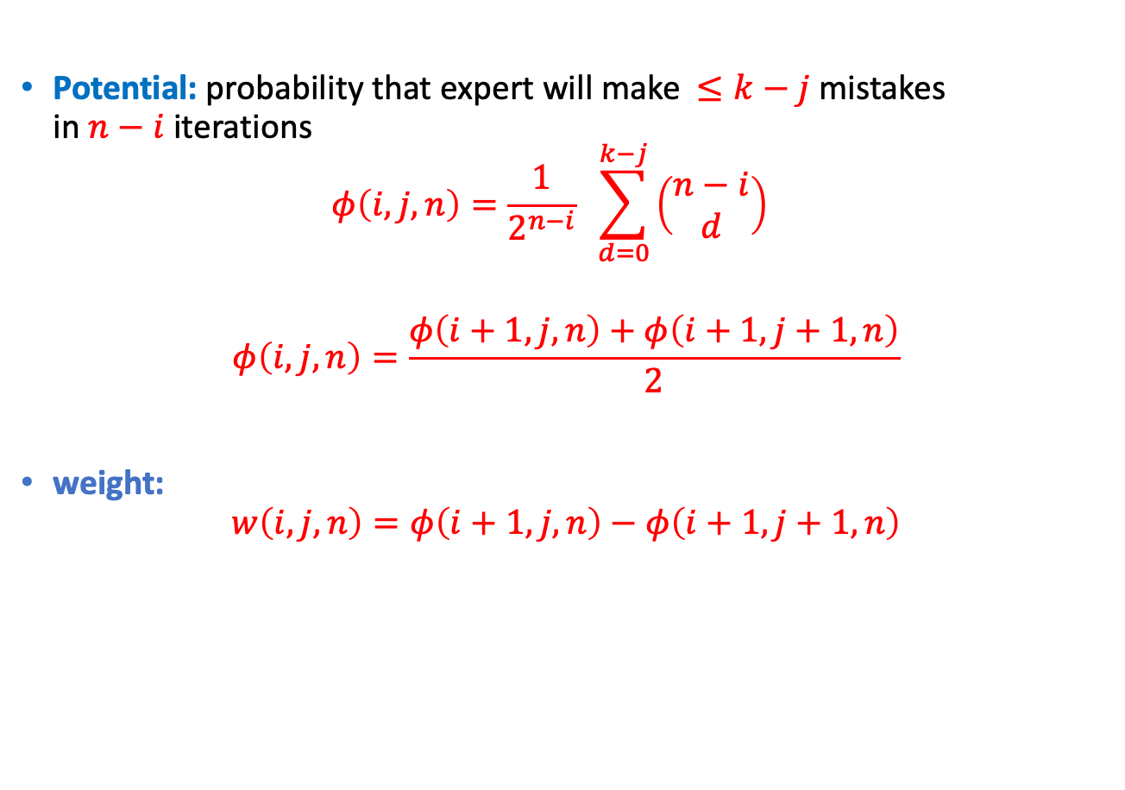
Recursive definition of the potential
Potential: probability that expert will make $≤k−j$mistakes in $n−i$ iterations $φ\left(i,j,n\right)=\frac{1}{2^{n−i}} \sum_{d=0}^{k−j}{\left(\begin{matrix}n−i \\ d\end{matrix}\right)}$
$$φ\left(i,j,n\right)=\frac{φ\left(i+1,j,n\right)+φ\left(i+1,j+1,n\right)}{2}$$
weight:
$$w\left(i,j,n\right)=φ\left(i+1,j,n\right)−φ\left(i+1,j+1,n\right)$$

Slide 19
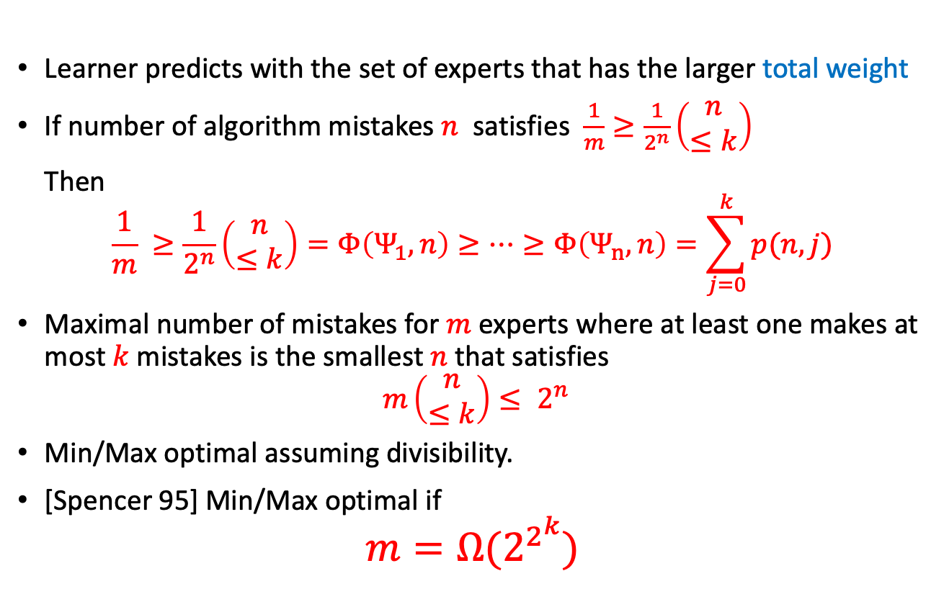
The BW Algorithm
Learner predicts with the set of experts that has the larger total weight
If number of algorithm mistakes $n$ satisfies $\frac{1}{m}≥\frac{1}{2^{n}}\left(\begin{matrix}n \\ ≤k\end{matrix}\right)$
Then
$$\frac{1}{m} ≥\frac{1}{2^{n}}\left(\begin{matrix}n \\ ≤k\end{matrix}\right)=Φ\left(Ψ_{1},n\right)≥⋯≥Φ\left(Ψ_{n},n\right)=\sum_{j=0}^{k}{p(n,j)}$$
Maximal number of mistakes for $m$ experts where at least one makes at most $k$ mistakes is the smallest $n$ that satisfies
$$m\left(\begin{matrix}n \\ ≤k\end{matrix}\right)≤ 2^{n}$$
Min/Max optimal assuming divisibility.
[Spencer 95] Min/Max optimal if
$$m=Ω(2^{2^{k}})$$

Slide 20
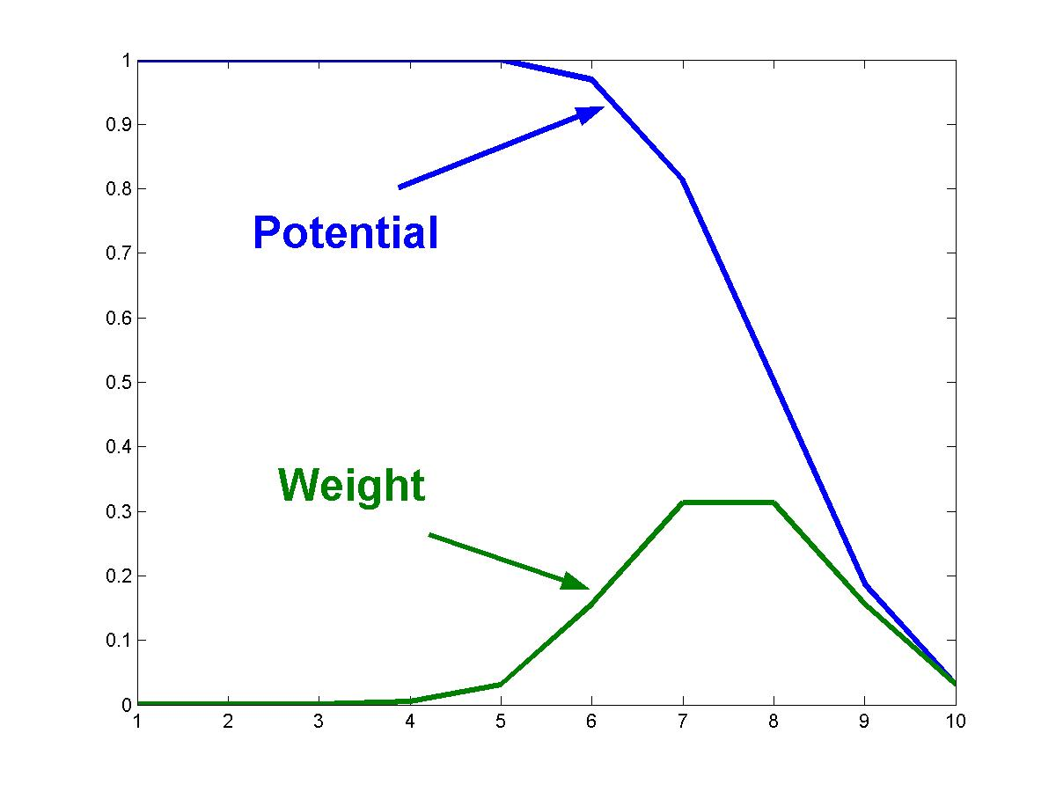
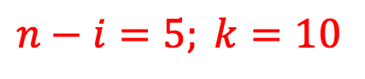
Example potential and weight
$$n−i=5; k=10$$
Expert dist

Slide 21
Ulam’s game with k lies
Player 1 chooses secret x from S1,S2,…,SN
Player 2 asks “is x in the set A?”
Player 1 can lie k times.
Game ends when player 2 can determine x.
A smart player 1 aims to have more than one consistent x for as long as possible.
Chip = element (Si)
Bin = number of lies made regarding element

Slide 22
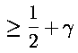
Boosting as a chip game
Chip = training example
Booster assigns a weight to each chip, weights sum to 1.
Learner selects a subset with weight
Selected set moves a step right (correct)
Unselected set moves a step left (incorrect)
Booster wins examples on right of origin.
Implies that majority vote is correct.

Slide 23
The boosting chip game
h(x) <> y
h(x) = y
.1
.2
.1
.2
.1
.2
.1
Majority vote is correct

Slide 24
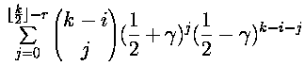
Binomial strategies for boosting
Learner moves chip right independently with probability ½+γ
The potential of example that is correctly classified r times after i out of k iterations
Booster assigns to each example a weight proportional to the difference between its possible next-step potentials.

Slide 25
Plan Of Talk
Online learning games
The Halving Game
The Binomial Game
Decision Theoretic Online Learning (DTOL)
Hedge
The continuous time limit and the heat equation.
NormalHedge
SDEs
Open Problems

Slide 26
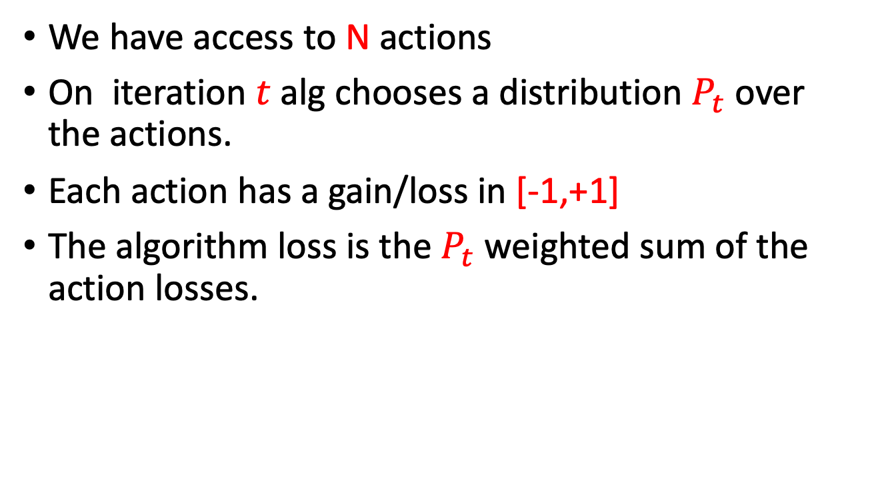
Decision Theoretic online learning
We have access to N actions
On iteration $t$ alg chooses a distribution $P_{t}$ over the actions.
Each action has a gain/loss in [-1,+1]
The algorithm loss is the $P_{t}$ weighted sum of the action losses.

Slide 27
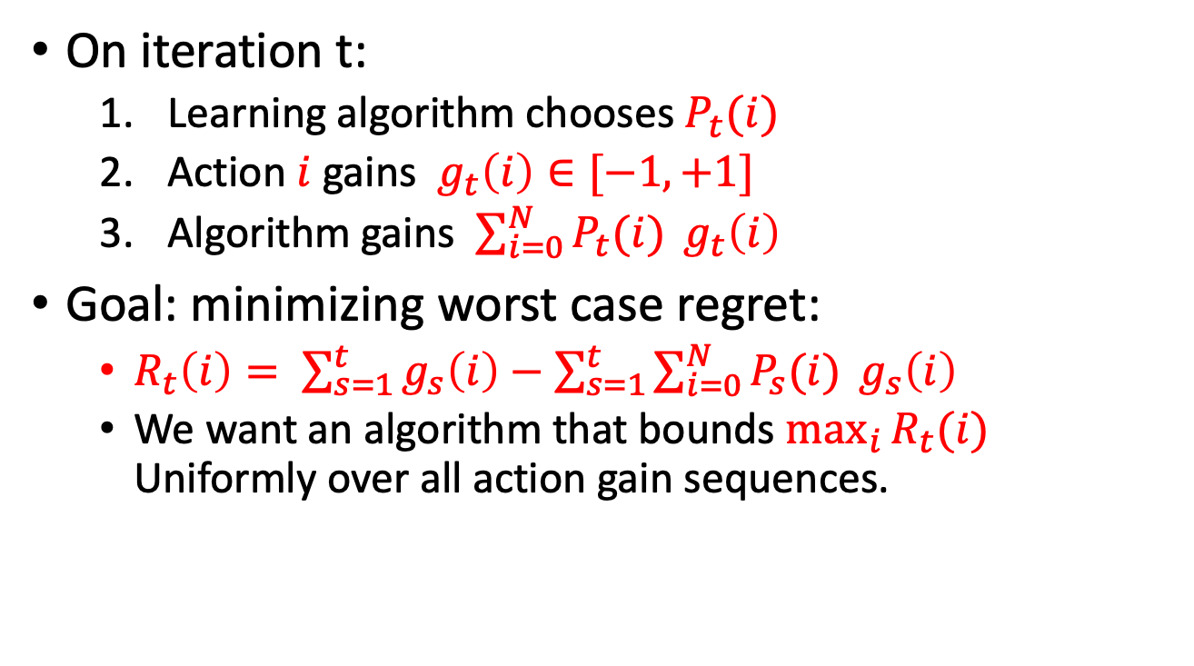
Decision theoretic online learning game
On iteration t:
Learning algorithm chooses $P_{t}(i)$
Action $i$ gains $g_{t}\left(i\right)∈[−1,+1]$
Algorithm gains $\sum_{i=0}^{N}{P_{t}(i) }g_{t}\left(i\right)$
Goal: minimizing worst case regret:
$R_{t}\left(i\right)= \sum_{s=1}^{t}{g_{s}\left(i\right)}−$ $\sum_{s=1}^{t}{\sum_{i=0}^{N}{P_{s}(i) }g_{s}\left(i\right)}$
We want an algorithm that bounds $\max_{i}{R_{t}(i) }$ Uniformly over all action gain sequences.

Slide 28
Plan Of Talk
Online learning games
The Halving Game
The Binomial Game
Decision Theoretic Online Learning (DTOL)
Hedge
The continuous time limit and the heat equation.
NormalHedge
SDEs
Open Problems

Slide 29
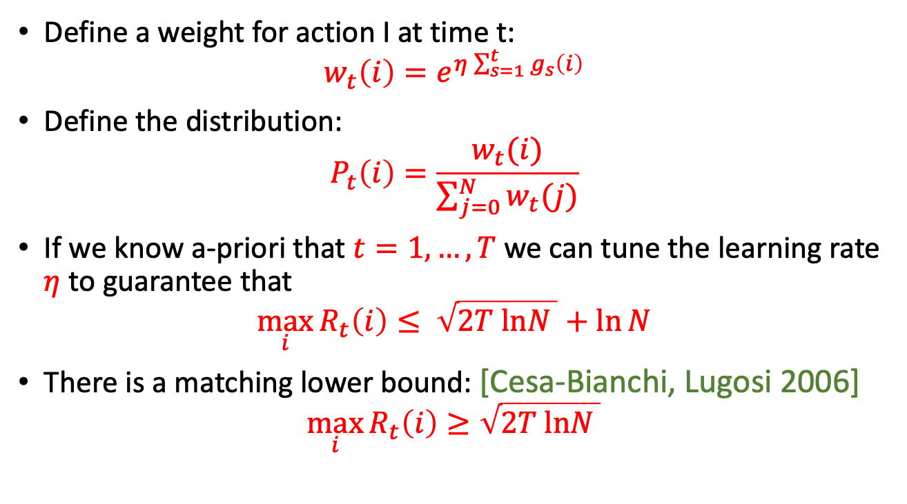
Hedge
[F,Schapire97]
Define a weight for action I at time t:
$$w_{t}\left(i\right)=e^{η\sum_{s=1}^{t}{g_{s}\left(i\right)}}$$
Define the distribution:
$$P_{t}\left(i\right)=\frac{w_{t}(i)}{\sum_{j=0}^{N}{w_{t}(j)}}$$
If we know a-priori that $t=1,…,T$ we can tune the learning rate $η$ to guarantee that
$$\max_{i}{R_{t}\left(i\right)≤ \sqrt{2T lnN }+\ln{N}}$$
There is a matching lower bound: [Cesa-Bianchi, Lugosi 2006]
$$\max_{i}{R_{t}\left(i\right)≥\sqrt{2T lnN }}$$

Slide 30
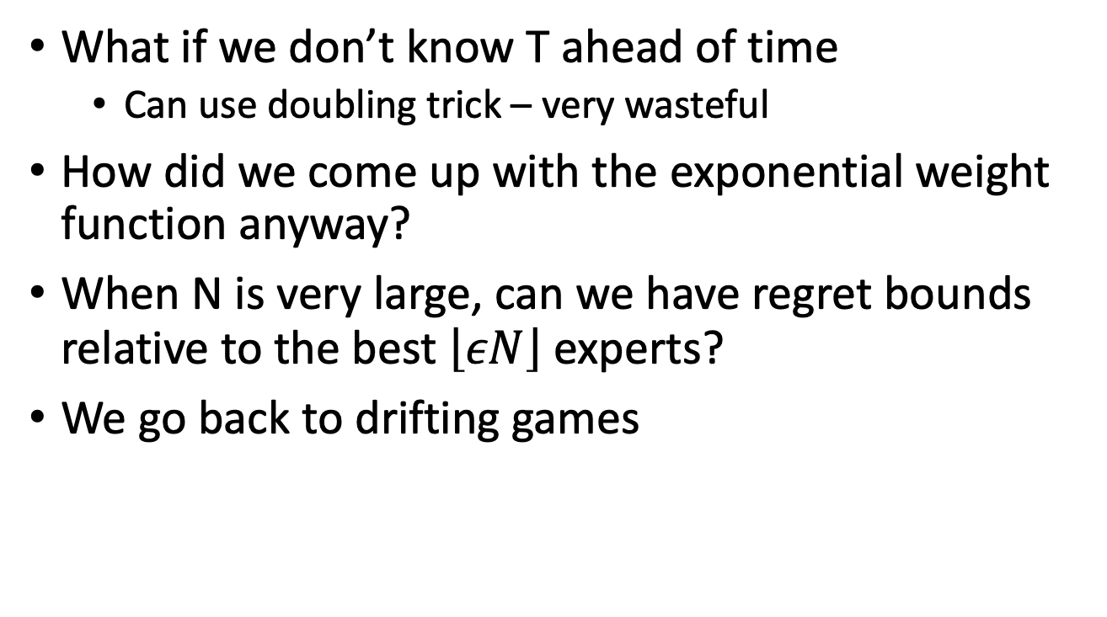
Remaining Questions
What if we don’t know T ahead of time
Can use doubling trick – very wasteful
How did we come up with the exponential weight function anyway?
When N is very large, can we have regret bounds relative to the best $\left\lfloor εN\right\rfloor$ experts?
We go back to drifting games

Slide 31
Plan Of Talk
Online learning games
The Halving Game
The Binomial Game
Decision Theoretic Online Learning (DTOL)
Hedge
The continuous time limit and the heat equation.
NormalHedge
SDEs
Open Problems

Slide 32
Getting off the grid
Instead of Making/not making a mistake -> suffering a loss in [-1,+1]
Instead of specifying a-priori the no. of mistakes of the best expert – bound regret to the best expert
Alg. sets weights over experts, suffers loss = weighted average
Experts
Experts
0.4
0.2
Cumulative loss
Cumulative loss
Algorithm
Algorithm

Slide 33
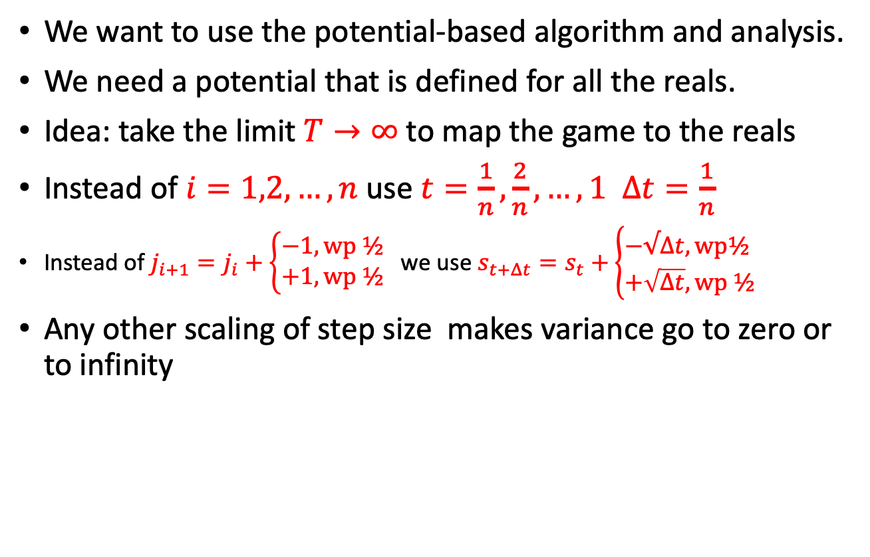
The continuous time heuristic
We want to use the potential-based algorithm and analysis.
We need a potential that is defined for all the reals.
Idea: take the limit $T→∞$ to map the game to the reals
Instead of $i=1,2,…,n$ use $t=\frac{1}{n},\frac{2}{n},…,1$ $Δt=\frac{1}{n}$
Instead of $j_{i+1}=j_{i}+\left\{\begin{aligned}−&1, wp ½ \\ +1,wp ½\end{aligned}\right.$we use $s_{t+Δt}=s_{t}+\left\{\begin{aligned}−&√Δt,wp½ \\ +\sqrt{Δt}, wp ½\end{aligned}\right.$
Any other scaling of step size makes variance go to zero or to infinity

Slide 34
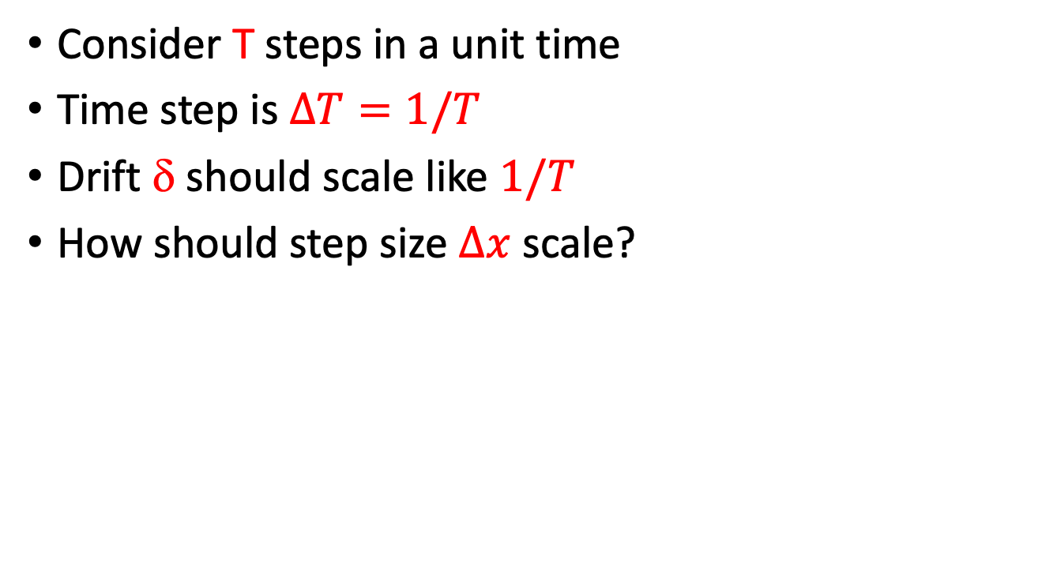
Increasing the number of steps
Consider T steps in a unit time
Time step is $ΔT=1/T$
Drift δ should scale like $1/T$
How should step size $Δx$ scale?

Slide 35
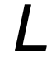
The game lattice
T=3, t=1,2,3
3
2
1
t
0
1
2
3
-1
-2
-3

Slide 36
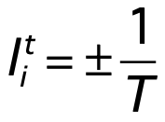
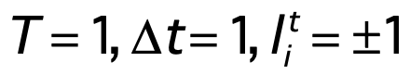
Using step
1
t
0
1
-1

Slide 37
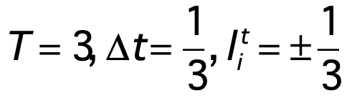
Using step
1
2/3
1/3
t
0
1/3
2/3
1
-1/3
-2/3
-1

Slide 38
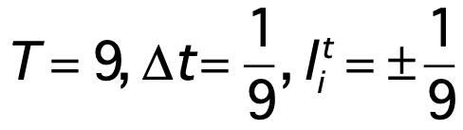
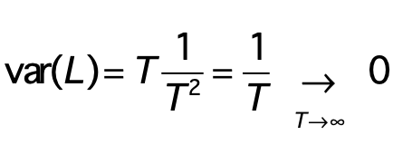
Using step
1
2/3
1/3
t
0
1/3
2/3
1
-1/3
-2/3
-1
Looks fine but

Slide 39
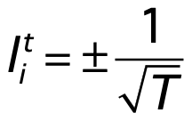
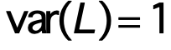
Using step
1
t
0
1
-1

Slide 40
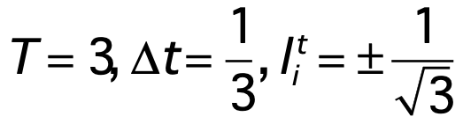
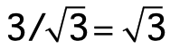
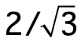

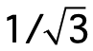
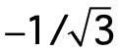
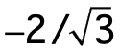
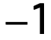
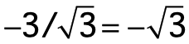
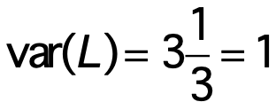
Using step
t
1/3
2/3
1

Slide 41
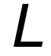
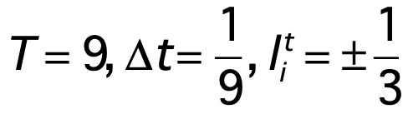
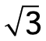
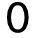
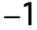
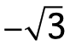
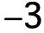
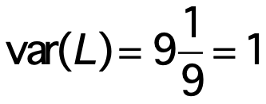
Using step
t
but range(L)→∞

Slide 42
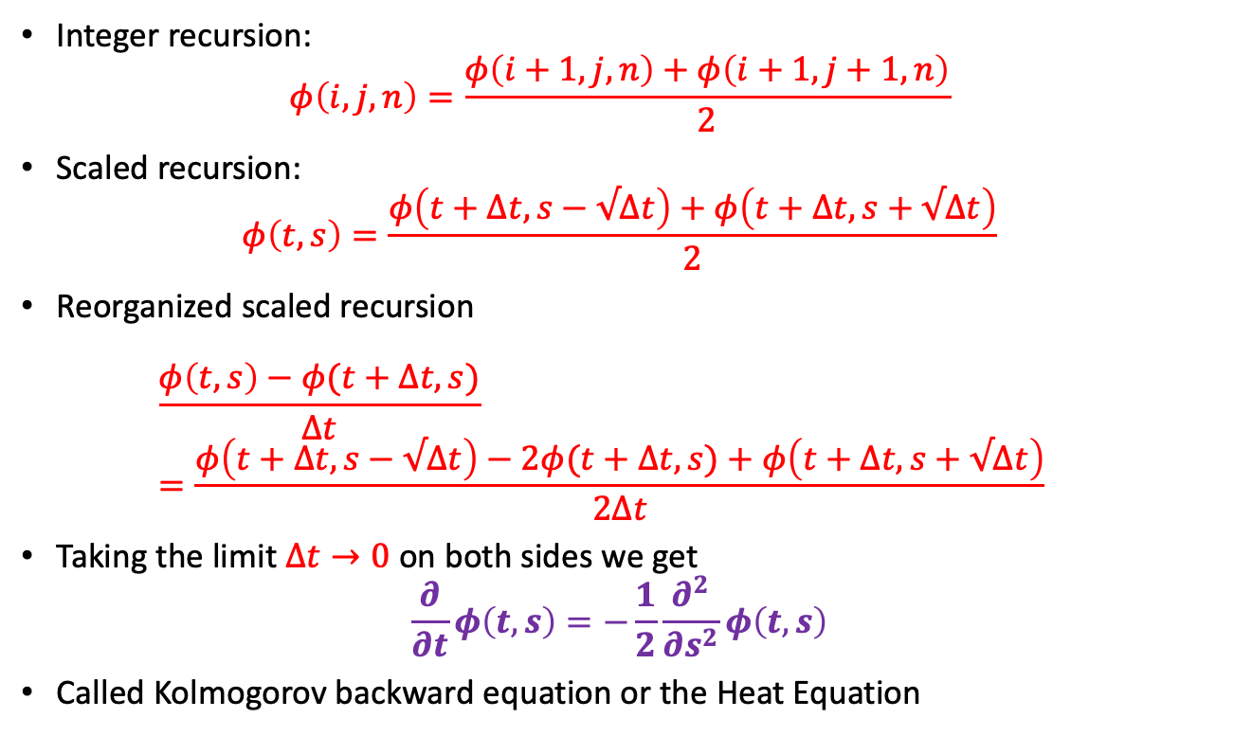
Potential recursion in continuous time
Integer recursion:
$$φ\left(i,j,n\right)=\frac{φ\left(i+1,j,n\right)+φ\left(i+1,j+1,n\right)}{2}$$
Scaled recursion:
$$φ\left(t,s\right)=\frac{φ\left(t+Δt,s−√Δt\right)+φ\left(t+Δt,s+√Δt\right)}{2}$$
Reorganized scaled recursion $\frac{φ\left(t,s\right)−φ(t+Δt,s)}{Δt}=\frac{φ\left(t+Δt,s−√Δt\right)−2φ(t+Δt,s)+φ\left(t+Δt,s+√Δt\right)}{2Δt}$
Taking the limit $Δt→0$ on both sides we get $\frac{∂}{∂t}φ\left(t,s\right)=−\frac{1}{2}\frac{∂^{2}}{∂s^{2}}φ\left(t,s\right)$
Called Kolmogorov backward equation or the Heat Equation

Slide 43
Plan Of Talk
Online learning games
The Halving Game
The Binomial Game
Decision Theoretic Online Learning (DTOL)
Hedge
The continuous time limit and the heat equation.
NormalHedge
SDEs
Open Problems

Slide 44
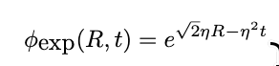
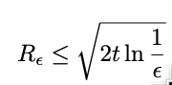
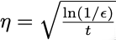


Closed form solutions for $\frac{dφ}{dt}=−\frac{1}{2}\frac{d^{2}φ}{dR^{2}}$
We want a potential that is positive, increasing and convex.
Time-dependent Hedge [Chernov, Vovk 2010]
$η$ needs to be chosen
Squint: Use mixture of $η$’s (Linear space of solutions)

Slide 45



Normal-Hedge
Normal-Hedge: [Chaudhuri, F, Hsu 2009]
And related algorithms [Luo, Schapire 2015],[Koolen, Erven 2015],[Orbona, Pal 2016]
Much more aggressive than Hedge
Holds simultaneously for all $ε,t$
No learning rate $η$ to tune
Slightly worse Constant than Hedge
$$R_{ε}=O\left(\sqrt{t\ln{\frac{1}{ε}}}\right)$$

Slide 46
Design of NormalHedge
BW: potential function depends on loss and number of remaining mistakes
Normal-Hedge: Potential function based on regret and variance of the positive cumulative regrets

Slide 47



The NormalHedge potential

Slide 48








NormalHedge algorithm

Slide 49



Illustrative Example
Expert
Algorithm
potential
Cumulative Gain

Slide 50
Illustrative Example
Expert
Algorithm
iteration t
potential
Cumulative Gain

Slide 51
Illustrative Example
Expert
Algorithm
iteration t+1
potential
Cumulative Gain

Slide 52

Illustrative Example
Expert
Algorithm
calc c(t+1)
potential
Cumulative Gain

Slide 53




Normal-Hedge Performance bound
[Chaudhuri, Freund & Hsu 2009]

Slide 54

Performance on flip-flop
Worst case for follow the leader

Slide 55


NormalHedge.DT / Luo and Schapire, 2014
Weight: $w\left(r,t\right)=ψ\left(r−1,t+1\right)−ψ(r+1,t+1)$

Slide 56


NormalHedge.DT / analysis

Slide 57



The NormalHedge potential

Slide 58








NormalHedge algorithm

Slide 59
Plan Of Talk
Online learning games
The Halving Game
The Binomial Game
Decision Theoretic Online Learning (DTOL)
Hedge
The continuous time limit and the heat equation.
NormalHedge
SDEs
Open Problems

Slide 60
The SDE approach
The heat equation characterizes the time evolution of the distribution over regrets.
Stochastic Differential Equations characterize the time evolution of the regret for each expert.
[F 2009],[Harvey, Liaw,Perkins 2020], [Harvey, Liao, Portella 2024],[Zhang, Yang, Cutosky, Paschalidis 2024] Use SDEs to analyze online learning algorithms.
A more refined tool that yields tighter bounds.

Slide 61
Plan Of Talk
Online learning games
The Halving Game
The Binomial Game
Decision Theoretic Online Learning (DTOL)
Hedge
The continuous time limit and the heat equation.
NormalHedge
SDEs
Open Problems

Slide 62

Open Questions
Are there bounds of the form $R_{ε}=O\left(\sqrt{V_{t}\ln{\frac{1}{ε}}}\right)$ Where $V_{t}$ is a cumulative second order quantity that depends on the squares of the instantaneous regret?
Think of changing the range of the losses from [-1,+1] to [-1/2,+1/2].
Are there “better” solutions of the heat equation?
Is there a “best” potential function that matches a second order lower bound?

Slide 63


Drifting games (in 2d)
Target
region

Slide 64
General Drifting Games

Slide 65
Drifting games (in 2d)
Target
region

Slide 66


General Potential function
[Schapire, Drifting Games, 99]
A potential defined by a min/max recursion
Shepherd’s strategy

Slide 67
Restricting allowable steps
We can simplify the min/max recursion for special step sets
B = the set of all allowable step
Normal B = minimal set that spans the space. With positive coefficients
Regular B = a symmetric normal set. (~orthonormal basis)
2
Regular step set in R

Slide 68



Slide 69


Optimal strategies when $δ→0$
Shephard: $\vec{w}=∇φ$
Sheep: choose each step with almost equal probability with small drift=$δ\vec{w}$

Slide 70



The solution when
The local slope becomes the gradient
The recursion becomes a PDE
Same PDE describes time development of
Brownian motion with drift

Slide 71
Special Cases
Target func. = PDE boundary condition at time=1.
Target func. = exponential
potential and weight are exponential at all times
Adaboost.
Exponential weights algs for online learning.
Target func. = step function
Potential is the error function, weight is the normal distribution.
Potential and weight change with time.
Brownboost.

Slide 72


Slide 73


Slide 74


Slide 75


Slide 76


Slide 77


Slide 78
Potential applications
Generalized boosting
Classification for >2 labels
Regression
Density estimation
Variational function fitting
Generalized online learning
Continuous predictions (instead of binary)

Slide 79
The End
I am teaching a class on online learning next quarter (winter) DSC291-topics in data science – online learning

Slide 80

Bounds for DTOL
Original: $R≺\sqrt{T\ln{N }}$
$T$ number of iterations,
$N$ number of actions
Quantile-based: $R≺\sqrt{Tln1/ε{ }}$
replace $N$ by $\frac{1}{ε}$
Second order: $R≺\sqrt{Vln1/ε{ }}$
Easy sequences: $\left|l\left(i,ω\right)\right|<1$
Replace $T$ by a sum of squared terms $V$?
Many variants

Slide 81

Variants of second order bounds.
Use ${\left(l\left(i,ω\right)\right)}^{2}$ (loss) or ${\left(l\left(i,ω\right)−ℓ\left(i\right)\right)}^{2}$ (regret)

Slide 82

Upper and lower potentials
Fixing $φ\left(T,R\right)$,learner P and adversarial Q strategies. Use backward recursion to define $φ_{P,Q}\left(t,R\right)$ for all $0≤t≤T$
Upper Potential: $φ_{P}^{↓}(t,R)$ fix P sup over all adversarial strategies
Lower Potential: $φ_{Q}^{↑}(t,R)$ fix Q inf over all Leaner strategies
Our goal: min-max pair: find $P^{∗},Q^{∗}$ such that
$$∀t,R: φ_{P^{∗}}^{↓}\left(t,R\right)=φ_{Q^{∗}}^{↑}(t,R)$$

Slide 83

Adversarial averaging strategy
$k≥0, s=2^{−k}, t=0,…,{T; T=2}^{2k}$
At each iteration, split each action into two: $l=\left\{\begin{matrix}+s & w.p.½ \\ −s & w.p.½\end{matrix}\right.$
${T=2}^{2k} so that V_{T}$ remains constant:
$$V_{T}={T s^{2}=2}^{2k} 2^{−2k}=1$$
Equalizing strategy: loss of learner is zero regardless of chosen weights.
Regret is defined by binomial distribution

Slide 84












Adversarial Strategy
Gain / Loss
$$−s$$
$$+s$$
$$s^{2}$$
$$φ\left(0,R\right)$$
$$V_{t}$$
$$φ\left(0,R\right)=$$
$$\frac{1}{16}φ(4s^{2},R−2s)$$
$$+\frac{4}{16}φ(⋅,R−s)$$
$$+\frac{6}{16}φ(⋅,R)$$
$$+\frac{4}{16}φ(⋅,R+s)$$
$$+\frac{1}{16}φ(4s^{2},R+2s)$$
Potential $φ(4s^{2},r)$

Slide 85





Learner’s “cord” strategy
Assume s is known
Assume per-iteration loss of learner is bounded $\left|ℓ\right|≤s^{2}$ - otherwise total loss of learner can be infinite.
$$P\left(t,R\right)=\frac{1}{Z}\left(φ\left(\left(t+1\right)s^{2},R+s+s^{2}\right)−φ\left(\left(t+1\right)s^{2},R−s−s^{2}\right)\right)$$
Potential $φ(r)$
Upper Bound
$$R−s−s^{2}$$
$$R$$
$$R+s+s^{2}$$

Slide 86

Upper and lower potential for described strategies.
Recursions for step size $s$
for learner “cord” strategy $φ_{cord(s)}^{↓} (ts^{2},R)=\frac{1}{2}\left(φ_{cord}^{↓}\left(\left(t+1\right)s^{2},R+s+s^{2}\right)+φ_{cord}^{↓}\left(\left(t+1\right)s^{2},R−s−s^{2}\right)\right)$
For adversarial averaging strategy $φ_{aver(s)}^{↑} (ts^{2},R)=\frac{1}{2}\left(φ_{aver}^{↑}\left(\left(t+1\right)s^{2},R+s\right)+φ_{aver}^{↑}\left(\left(t+1\right)s^{2},R−s\right)\right)$
Solution in both cases is a binomial average
Let $B\left(a,n,b\right)=a+\sum_{i=1}^{n}{x_{i}}$; $x_{i}$IID RV $±a$ with prob $\frac{1}{2},\frac{1}{2}$
$φ_{cord(s)}^{↓} (ts^{2},R)=$ $E_{ρ∼B(R,T−t,s+s^{2})}\left(φ(T,ρ)\right)$
$φ_{aver(s)}^{↑}\left(ts^{2},R\right)=E_{ρ∼B(R,T−t,s)}\left(φ(T,ρ)\right)$

Slide 87

Taking the limit
Let $s=2^{−k}$
The grid for k+1 is a superset of the grid for k
For any $(v,R)$ that are on the grid for some $k$, $\lim_{k→∞}{{[φ}_{cord(2^{−k})}^{↓}\left(v,R\right)− φ_{aver\left(2^{−k}\right)}^{↑}\left(v,R\right)]=0 }$
Density of grids + continuity: There is a limit potential $φ^{∗}$ such that for $∀R,0≤v≤V_{T}; φ^{∗}\left(v,R\right)=$ $\lim_{s→0}$ $φ_{cord(s)}^{↓}\left(v,R\right)=\lim_{s→0} φ_{aver\left(s\right)}^{↑}\left(v,R\right)$
The limit corresponds to Brownian Motion.
But is this limit min max?
We need to show that the adversary prefers smaller steps
We show that the lower potential for k+1 is always strictly higher than the potential for k

Slide 88













The adversary prefers smaller steps
Suppose $φ\left(T,R\right)∈𝒫^{4}$ (four strictly positive derivatives)
Potential for 4 steps of size $\frac{s}{2}$ is higher than potential for 1 step of size $s$
$$\frac{1}{16}φ(4s^{2},R−2s)$$
$$+\frac{4}{16}φ(⋅,R−s)$$
$$+\frac{6}{16}φ(⋅,R)$$
$$+\frac{4}{16}φ(⋅,R+s)$$
$$+\frac{1}{16}φ(4s^{2},R+2s)$$
$$− \frac{1}{2}φ(⋅,R−s)$$
$$− \frac{1}{2}φ(⋅,R+s)$$
$$\frac{1}{16}φ(4s^{2},R−2s)$$
$$−\frac{4}{16}φ(⋅,R−s)$$
$$+\frac{6}{16}φ(⋅,R)$$
$$−\frac{4}{16}φ(⋅,R+s)$$
$$+\frac{1}{16}φ(4s^{2},R+2s)$$

Slide 89
Step 5: continuous time.

Slide 90


Letting step-size $→0$
For $j=1,2,3,…$
$Q_{j}^{∗}:$ Adversary makes $2^{2j}$ steps of ${±s}_{j}=±2^{−j}$ (wp ½, ½ )
$P_{j}^{∗}$:$w\left(t,R\right)= \frac{1}{Z}(φ\left(t+s_{j}^{2},R+s_{j}+s_{j}^{2}\right)−$ $φ\left(t+s_{j}^{2},R−s_{j}−s_{j}^{2}\right))$
${ φ}_{Q_{j+1}^{∗}}^{↑}\left(t,R\right)$> $φ_{Q_{j}^{∗}}^{↑}\left(t,R\right)$ : adversary prefers smaller steps
$\lim_{j→∞}$ $\left[φ_{P_{j}^{∗}}^{↓}\left(t,R\right)−φ_{Q_{j}^{∗}}^{↑}\left(t,R\right)\right]=$0 : with smaller steps upper and lower converge
As adversary controls step size:
$φ^{∗}\left(t,R\right)=\lim_{j→∞}φ_{P_{j}^{∗}}^{↓}\left(t,R\right)=\lim_{j→∞}φ_{Q_{j}^{∗}}^{↑}\left(t,R\right)$ is the min-max potential.

Slide 91
From limit of strategies to strategy in the limit.
The learner wants to protect itself against all adversaries.
The sup of alpha-star l adversarial lower bound is when s->0.
The learner wants to protect itself against

Slide 92

The limit of infinitesimal steps
Letting $s→0$ the adversary’s strategy converges to Brownian Motion.
Theorem: if $φ\left(T,R\right)∈𝒫^{4}$ then the min max strategy for the adversary is Brownian motion.
The backwards recursion become Kolmogorov’s Backward Equation for Brownian motion: $\frac{dφ}{dt}=−\frac{d^{2}φ}{dR^{2}}$
Learner’s weight function is $w\left(t,R\right)= \frac{∂}{∂R}φ(t,R)$

Slide 93
Open Problems
Is there a second order bound on NormalHedge?
Is there a min/max strategy?

Slide 94


How to choose $φ(t,R)$ ? (1)
Min/max, Fixed Horizon: $∀R,\underset{ρ∼Ψ}{Pr}\left(ρ≥R\right)≤G(R)$
Brownian motion generates normal distribution:
$G\left(R\right)=\frac{1}{\sqrt{2πT}}\int_{R}^{∞}{e^{−\frac{x^{2}}{2T}} dx}$
Use potential $φ\left(T,R\right)=\frac{1}{G(R)}$
Min/Max but not practical.
Requires knowing $T$ in advance.

Slide 95
Discrete alg. for continuous time
Fractional time game starts with adversary declaring step size -- not realistic
We want a discrete time algorithm that operates in a continuous time environment.
Alternative description of expert cumulative gain: Brownian motion with drift rate and diffusion rate.

Slide 96



Potential $φ(r)$
Gradient
Upper Bound 1
Upper Bound 2
$$R−1$$
$$R$$
$$R+1$$

Slide 97
Second order algorithm

Slide 98

A second order bound
Weight first order derivative: $w\left(t,R\right)= \frac{∂}{∂R}φ(t,R)$
Drift $B\left(t,R\right)=E(l(t,ω)|R)$
Hessian second order derivative: $H\left(t,R\right)= \frac{∂^{2}}{∂R^{2}}φ(t,R+1)$
Diffusion: $D\left(t,R\right)=E\left[{\left(l\left(t,ω\right)−ℓ\left(t\right)\right)}^{2}|R\right]$
Time update: $t_{i+1}=t_{i}+E\left[H\left(t_{i},R\right)D(t_{i},R)\right]$
Bound: $Φ\left(T\right)≤Φ\left(0\right)$

Slide 99



The end, Thank You!
Log-prices can be modeled as Brownian motion:
Return$≈$ Drift
Volatility $≈$Diffusion $≈$std

Slide 100
In many situations, the worst thing that the adversary can do is random walk.
Knowing that is the worst case, we can devise good, often min/max optimal strategies.
Brownian Motion is at the core of many problems: Finance, Control, there might be some interesting connections.
Also interesting: Assume that the expert losses are drawn IID.

Slide 101

Increasing the number of steps
Consider T steps in a unit time
Drift δ should scale like 1/T
Step size O(1/T) gives game to shepherd
Step size keeps game balanced

Slide 102



The continuous time limit

Slide 103
Plan of talk
How to use expert advice, A quick tour of some old results.
Decision Theoretic Online Learning
Hedge
Binomial Weights
Normal Hedge
Open problem

Slide 104


Open Problem
Luo and Schapire got rid of the dependence on N
What about the dependence on T?
Suppose that, although loss is bounded in [0,1], it turns out that the loss is always in [0,1/2].
If alg. has information in advance, bound is halved
Equivalently:
Can we achieve this performance without a -priori knowledge?
Hypothesis: The increase c(t+1)-c(t) for normal hedge can upper bounded by a function of the form
Without degrading current performance.

Slide 105

Recent Progress
Schapire and Liu 2015:
AdaNormalHedge, an adaptive version of NormalHedge.DT

Slide 106
Open Problem
Luo and Schapire got rid of the dependence on N
What about the dependence on T?
Suppose that, although loss is bounded in [0,1], it turns out that the loss is always in [0,1/2].
If alg. has information in advance, bound is halved
Equivalently:
Can we achieve this performance without a -priori knowledge?
Hypothesis: The increase c(t+1)-c(t) for normal hedge can upper bounded by a function of the form
Without degrading current performance.

Slide 107
Hypothesis
In the bound on NormalHedge, T can be replaced by cumulative variance.
Similar to measuring return vs. volatility in the stock market.

Slide 108
Hedging differentiable processes
is trivial
Cumulative gain
Time

Slide 109

Intersections of Stochastic processes are complex

Slide 110


Slide 111
Thank You!

Slide 112


The Hedge Algorithm
[Freund & Schapire 1997]
based on [Littlestone and Warmuth 1989],[Cesa-Bianchi et al 1997]
Learning rate
Posterior
probability
(un-normalized)
Prior
probability

Slide 113




Potential-based bound
Large loss of algorithm => small potential
Good expert=> large potential
Combining, we get:

Slide 114

Tuning the learning rate

Slide 115

Tuning the learning rate
Is it possible to do better?

Slide 116
Plan of talk
How to use expert advice, A quick tour of some old results.
Decision Theoretic Online Learning
Hedge
Binomial Weights
Normal Hedge
Open problem

Slide 117
Performance on flip-flop
Worst case for follow the leader

Slide 118


NormalHedge.DT / Luo and Schapire, 2014

Slide 119


NormalHedge.DT / analysis

Slide 120

Equalizing adversary
Assume divisibility
Equalizing adversary splits each bin into two equal prob subsets.
$$\operatorname{Pr}\left[s_{i}\left(ω\right)=1| the past\right]=\frac{1}{2}$$
State sequence independent of learner’s choices.
Score is constant $\left(Ψ_{1},n\right)=Φ\left(Ψ_{2},n\right)=⋯\frac{1}{2^{n}}\left(\begin{matrix}n \\ ≤k\end{matrix}\right)=Φ=Φ\left(Ψ_{n},n\right)$
If two future configurations have different scores, learner chooses the one with lower score. $Φ\left(Ψ_{i},n\right)>Φ\left(Ψ_{i+1},n\right)$
And therefore $\frac{1}{2^{n}}\left(\begin{matrix}n \\ ≤k\end{matrix}\right)>Φ\left(Ψ_{n},n\right)$
$\frac{1}{2^{n}}\left(\begin{matrix}n \\ ≤k\end{matrix}\right)$ Is the min/max score

Slide 121

potentials and weights
We can write the score as a sum over bins
$$Φ\left(Ψ_{i},n\right)=\operatorname{Pr}\left(L\left(ω,n\right)≤k | Ψ_i\right) =\sum_{j=0}^{k}{\operatorname{Pr}\left(L\left(ω,n\right)≤k | L\left(ω,i\right)=j\right) Pr\left(L\left(ω,i\right)=j\right)}=\sum_{j=0}^{k}{ φ\left(i,j,n\right) p(i,j)}$$
We call $φ\left(i,j,n\right)$ the potential, = the probability of an expert to be “good” on the final iteration given that it has made $j$ mistakes in the first $i$ iterations.
$Ψ_{i+1}^{0}$, $Ψ_{i+1}^{1}$ : the configuration reached if learner predicts 0,1 and is wrong.
Algorithm has to find which of $Φ(Ψ_{i+1}^{0})$, $Φ\left(Ψ_{i+1}^{1}\right)$ is smaller.
Find sign of $Φ\left(Ψ_{i+1}^{1},n\right)−$ $Φ\left(Ψ_{i+1}^{0},n\right)$ $=\sum_{j=0}^{k}{ φ\left(i+1,j,n\right) \left[p^{1}\left(i+1,j\right)−p^{0}\left(i+1,j\right)\right]}$ $=\sum_{j=0}^{k}{ \left[φ\left(i+1,j+1,n\right)−φ\left(i+1,j,n\right)\right]}\operatorname{Pr}\left(e_{i}(ω)=1 | L_{i}(ω\right)=j)$ = $\sum_{j=0}^{k}{ w(i,j,n)}\left(2\operatorname{Pr}\left(e_{i}(ω)=1 | L_{i}(ω\right)=j)−1\right)$
We call $w(i,j,n)$ the weight , it is the difference between neighboring potentials.

Slide 122
Plan Of Talk
Online learning games
The Halving Game
The Binomial Game
Ulam’s game with K lies
Boosting Games
General Drifting Games
Drifting Games in Continuous time
BrownBoost
NormalHedge
An open problem

Slide 123
21 questions with k lies
Player 1 chooses secret x from S1,S2,…,SN
Player 2 asks “is x in the set A?”
Player 1 can lie k times.
Game ends when player 2 can determine x.
A smart player 1 aims to have more than one consistent x for as long as possible.
Chip = element (Si)
Bin = number of lies made regarding element

Slide 124
Chip game for 21 questions
element in A
element not in A
0
1
K
K+1
No. of lies made assuming
element is the secret
Game ends when there
is only one chip on this side

Slide 125
Cesa-Bianchi, F, Helmbold, Warmuth, 1996, On-line prediction and conversion strategies
Start
End
By following this expert the learner will not
make any more errors
0
1
K
Not in pool
0
1
K
Not in pool
No of mistakes made by expert
No of mistakes made by expert

Slide 126

Relation to experts with k lies
Same chip game, chooser vs splitter.
Experts: Chooser makes predictions.
Guessing: Chooser answers membership questions.
Slightly different stopping condition:
Experts: $≤ε$ remains in bin K
Guessing: $≤ε$ remains in bins 1..K.
Opposite goals:
Experts: chooser chooses prediction make the game short.
Guessing: chooser chooses answer to make game long.

Slide 127

Optimality of strategy
If the chips are infinitely divisible then the
solution is min/max optimal
[Spencer95] Enough for optimality if number of chips is at least

Slide 128
Plan Of Talk
Online learning games
The Halving Game
The Binomial Game
Ulam’s game with K lies
Boosting Games
General Drifting Games
Drifting Games in Continuous time
BrownBoost
NormalHedge
An open problem

Slide 129
Boosting
Methods for improving classifier accuracy
Weak Learner: a learning algorithm generating rules slightly better than random guessing.
Basic idea: re-weight training examples to force weak learner into different parts of the space.
Combine weak rules by a majority vote.

Slide 130
Boosting as a chip game
Chip = training example
Booster assigns a weight to each chip, weights sum to 1.
Learner selects a subset with weight
Selected set moves a step right (correct)
Unselected set moves a step left (incorrect)
Booster wins examples on right of origin.
Implies that majority vote is correct.

Slide 131
The boosting chip game
h(x) <> y
h(x) = y
.1
.2
.1
.2
.1
.2
.1
Majority vote is correct

Slide 132
Binomial strategies for boosting
Learner moves chip right independently with probability ½+γ
The potential of example that is correctly classified r times after i out of k iterations
Booster assigns to each example a weight proportional to the difference between its possible next-step potentials.

